Slide 1
REVIEW!

Slide 2
What is this?

Slide 3
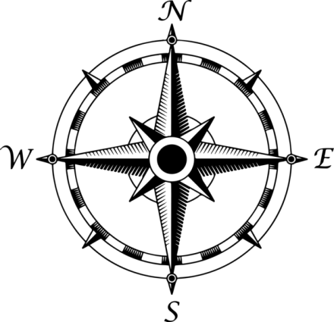
What is this?

Slide 4
Compass Rose!
A compass rose is used to determine direction on a map.

Slide 5
Which way is West?

Slide 6
Which way is West?
N

Slide 7
What is this?

Slide 8
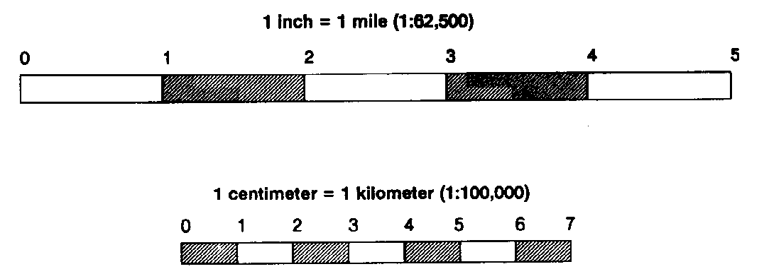
What is this?

Slide 9
Map Scale!
Map scales are used to determine the ratio of the map. Because maps are much smaller than the actual Earth, the map scale allows you to determine distance in relation to the Earth.

Slide 10
For the Next Few Questions
Use the map found in the textbook on pages
A28 – A 29

Slide 11
What country am I in?
50°N, 10°E

Slide 12
Germany!

Slide 13
What country am I in?
50°N, 30°E

Slide 14
Ukraine!

Slide 15
What country am I in?
60°N, 40°E

Slide 16
Russia!

Slide 17
What city is intersected by the Prime Meridian (Longitude 0°)

Slide 18
What city is intersected by the Prime Meridian (Longitude 0°)
London!

